Slide 1
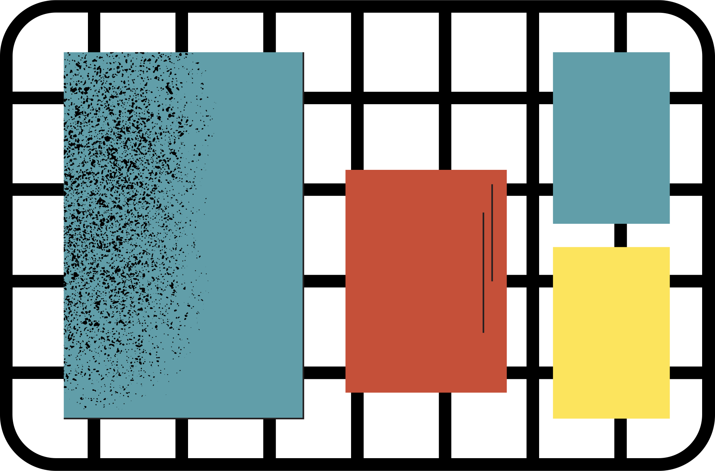



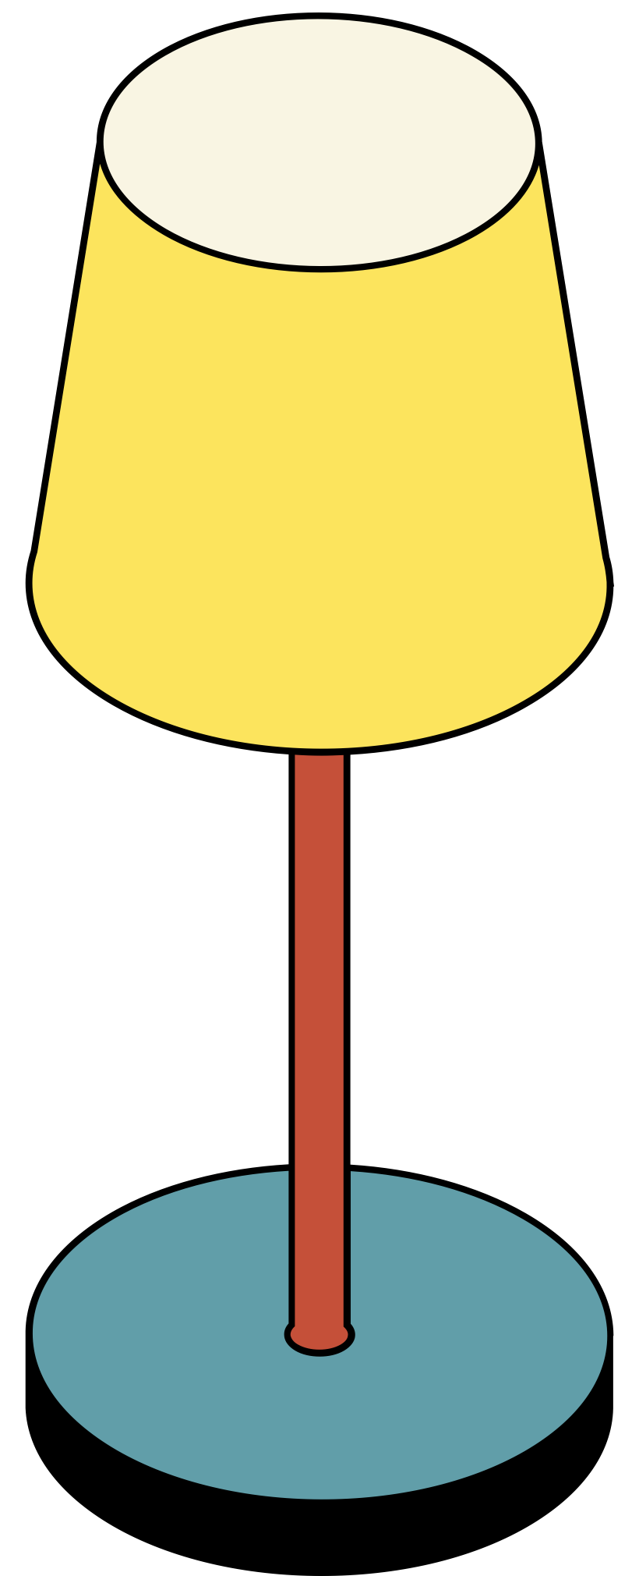

Breaking the Cycle of Academic Failure
Leveraging Predictive Analytics to Identify At-Risk Students and Optimize Interventions
Satria – DS32A

Slide 2



README
🎓 Education: Mining Engineering (ITB) + Master's in Predictive Analytics (Curtin University)
💼 Experience: AdOps Specialist, Programmatic Campaign Manager, Research Assistant - specialized in data-driven solutions & mining safety
🎯 Passion: Bridging traditional mining with cutting-edge analytics to enhance operational efficiency & sustainability

Slide 3
PREVIOUS PROJECTS
Indonesian Tweet Sentiment Analysis
Beezness: Bee Farm Modelling with Python
Student Performance Predictive Analysis with R

Slide 4


Business Understanding
Background:
Schools react to student problems instead of preventing them. When help comes after students are already failing, it's less effective and leads to higher dropout rates.
Problem Statement:
Current methods identify at-risk students too late, causing high failure rates.
ADD OBJECTIVE
This project will build a predictive model to identify student risk with over 90% accuracy, enabling timely, proactive interventions to improve success and retention.

Slide 5
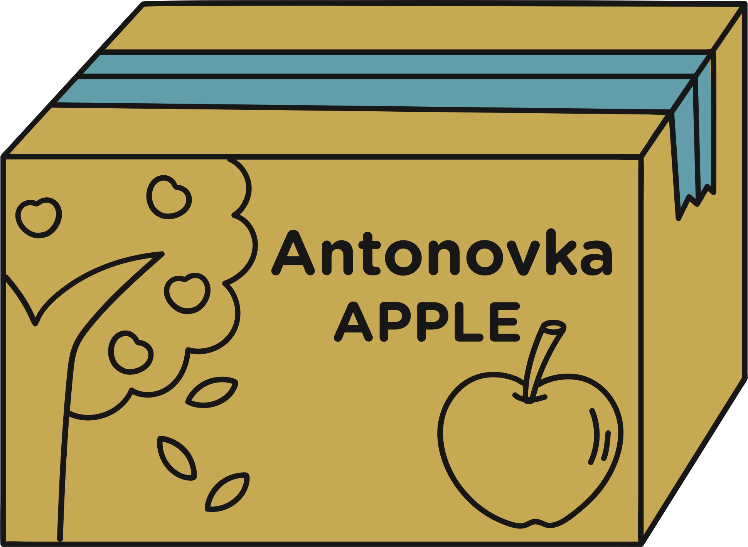

Data Understanding
Overview
662 students across Mathematics and Portuguese subjects with 33 features covering demographics, social factors, academic history, and behavioural patterns.
Quality:
No missing values, low-moderate duplication because some students take both Math and Portuguese. Around 55% of students are taking both subjects, 40% Portuguese only, and 5% Math only.

Slide 6
ADD MORE DATA CLEANING DETAILS
Overview
662 students across Mathematics and Portuguese subjects with 33 features covering demographics, social factors, academic history, and behavioural patterns.

Slide 7
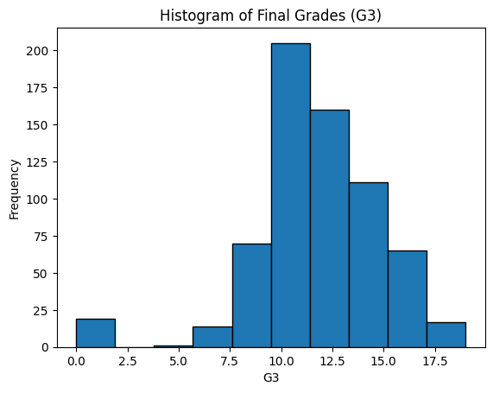
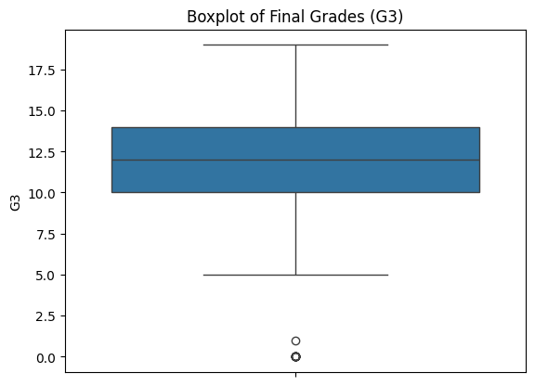

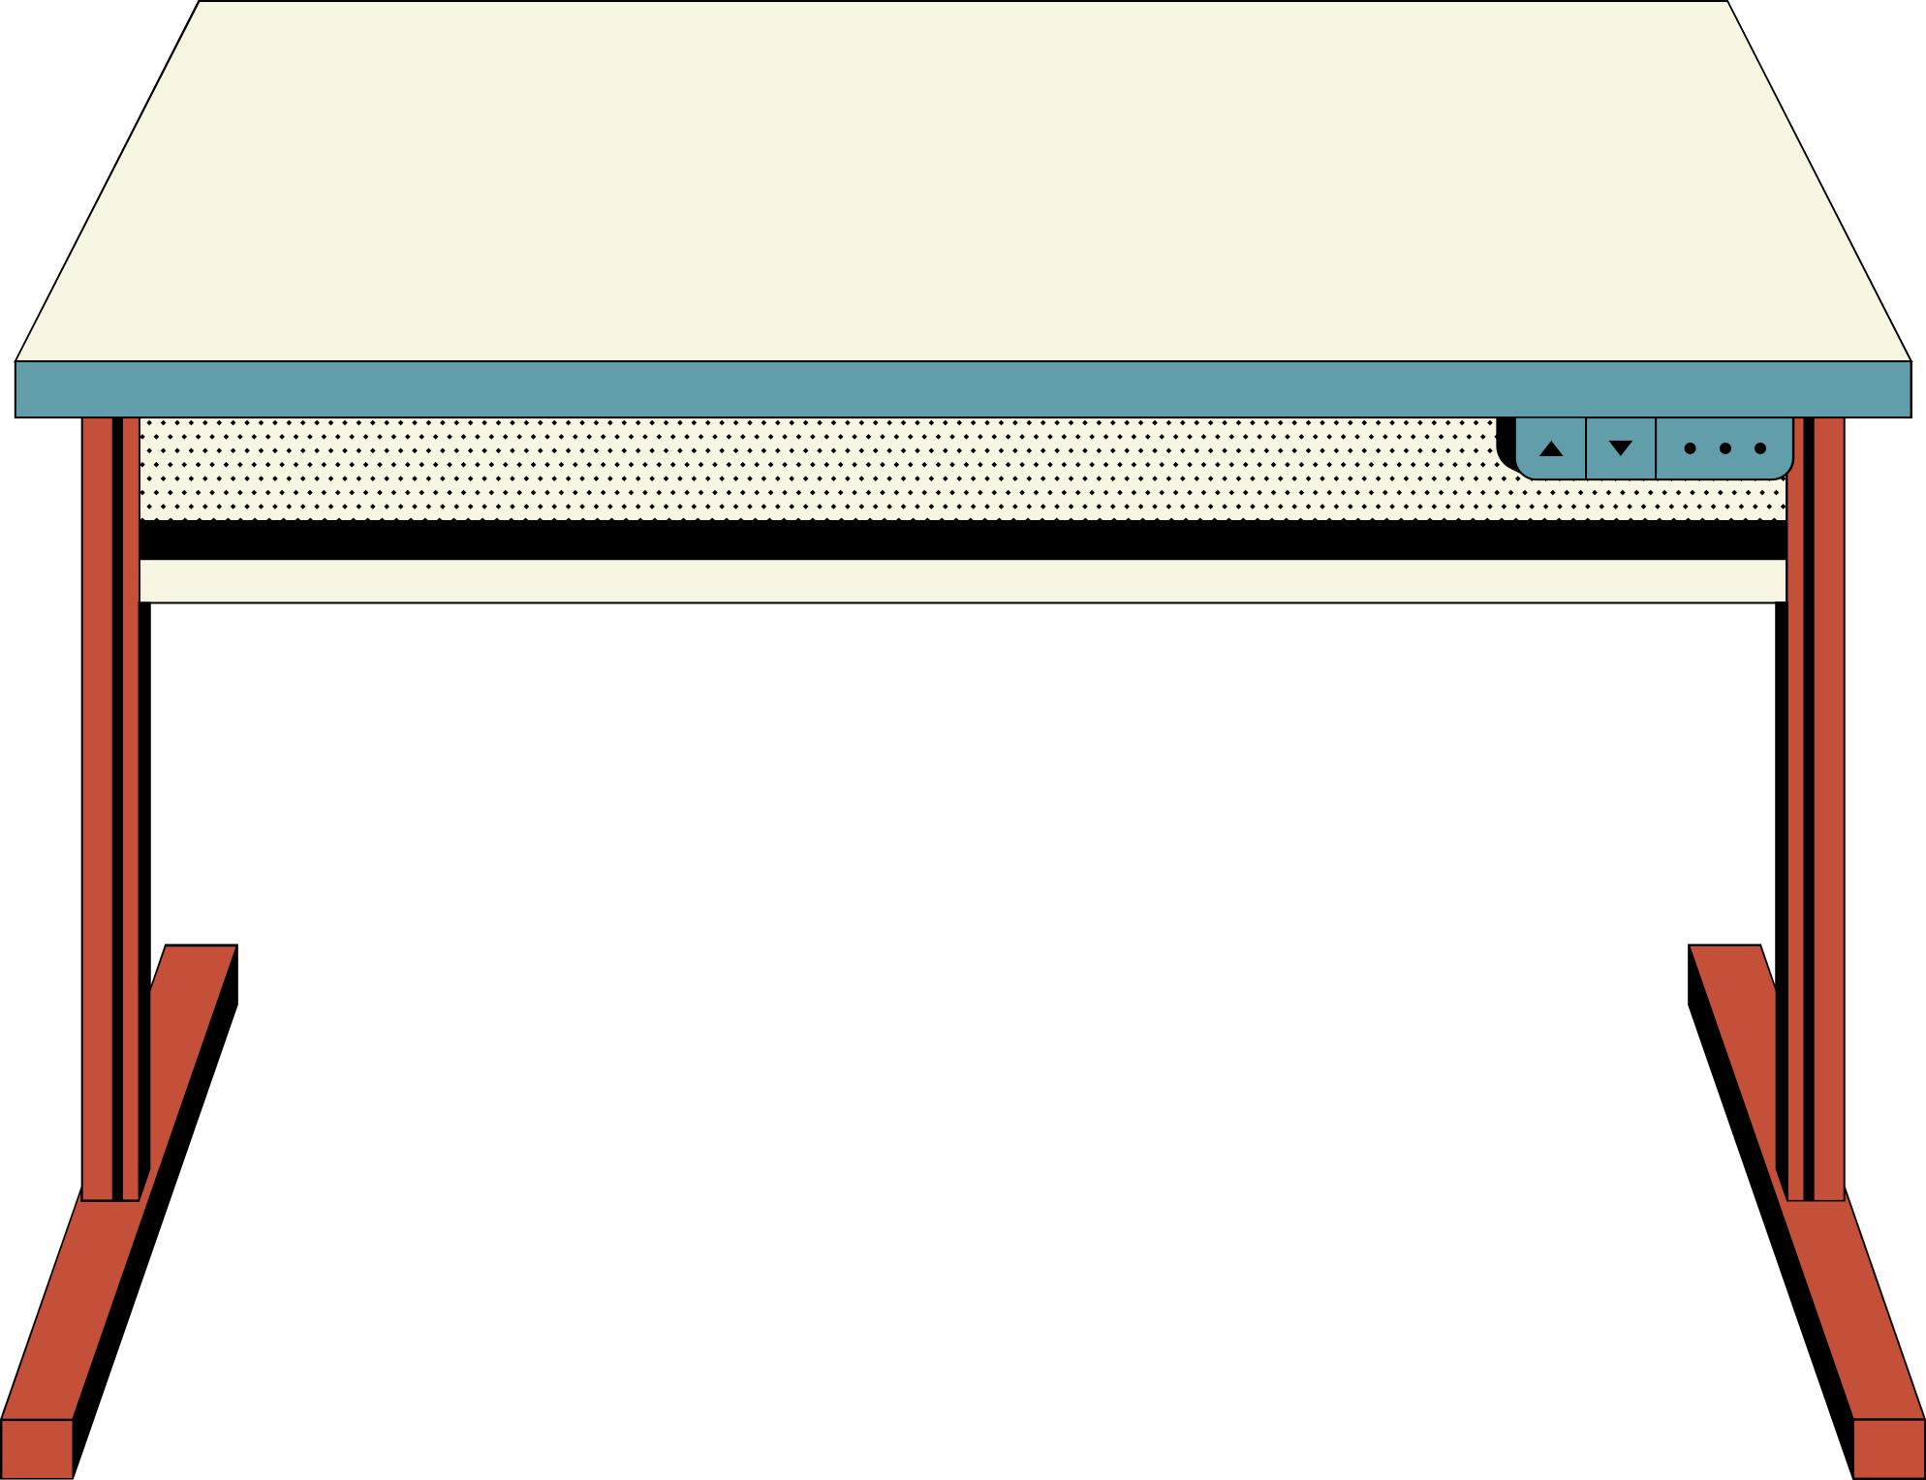

EDA
Exploratory Data Analysis
The G3 average score is ~12.5, and most students performs at average to slightly above-average levels (right-skewed distribution).
No outlier on the higher end, inferring that high performer is rare or the data is clean from higher end outlier. However, there is a small number of outlier on the lower end of the boxplot.
There are students below average levels performance and lower outlier performer that could benefit most from early intervention.

Slide 8
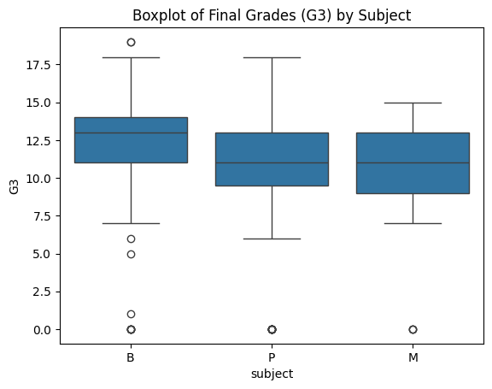
EDA
Exploratory Data Analysis
From the boxplot, students who take both subjects perform better than those who take only one. In the Jupyter notebook, there are several more findings from the boxplot of each column against G3, such as:
Student who have more than 7 absences seems to perform better than those who are never absent.
Students who go to GP performed better than those who go to MS.
The higher the parents' education, the better the G3 score.
Students whose parents work in the health or education sector show a better G3 score.
… and many more

Slide 9
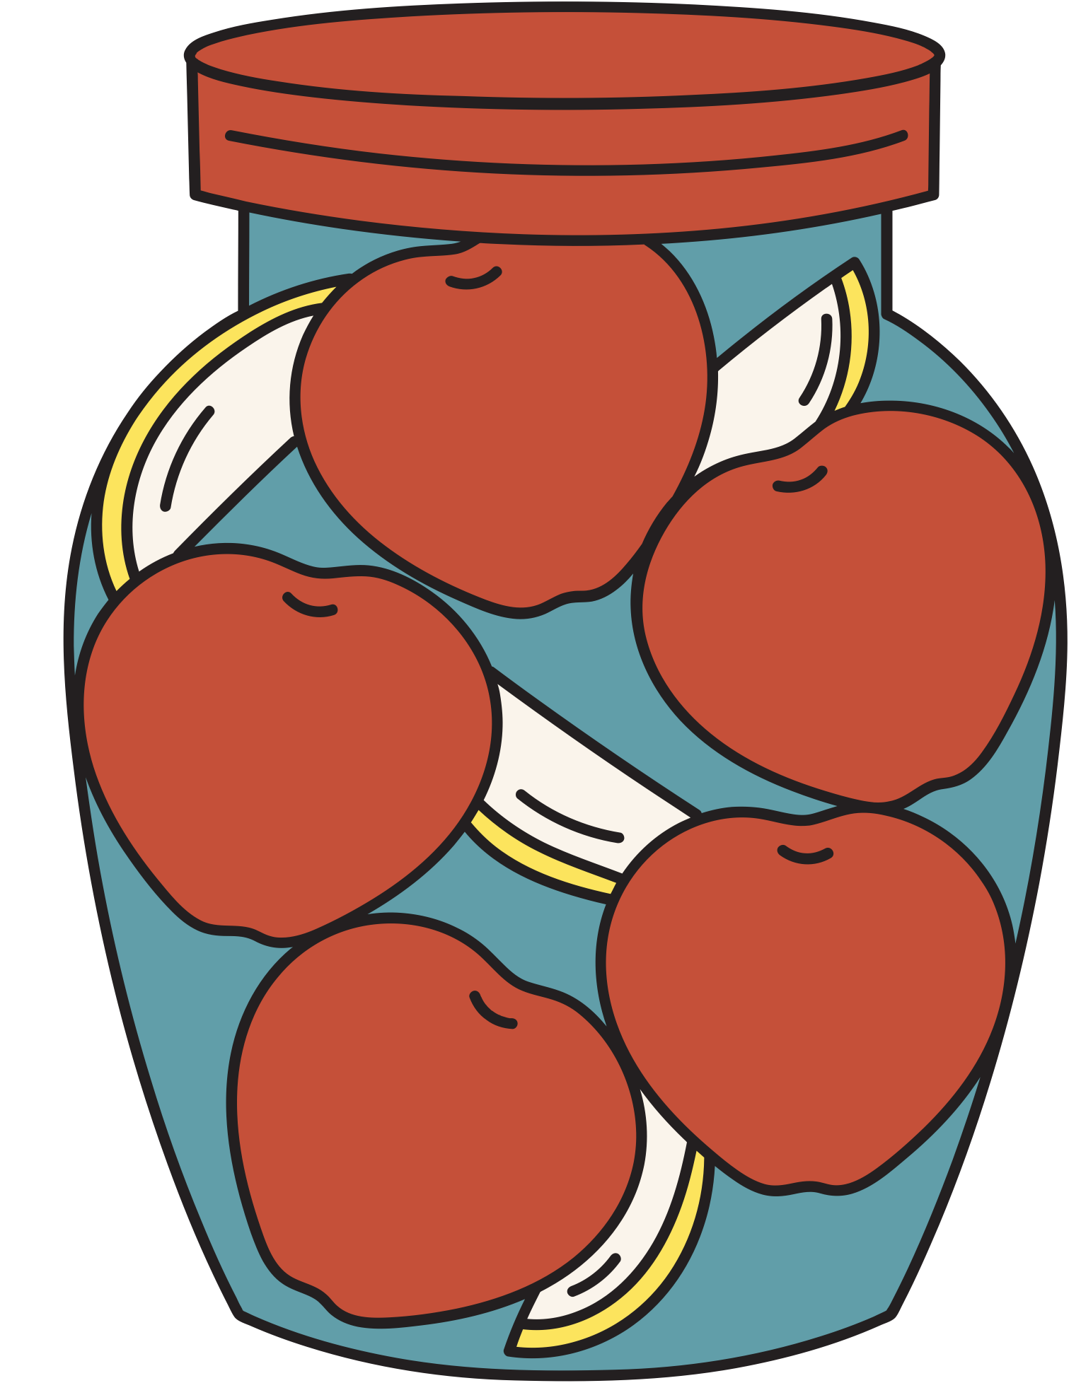
Pickled
Apples
To be
Continued. . .

Slide 10
HOW TO USE THIS PRESENTATION
Google Slides
PowerPoint
Canva
Click on the "Google Slides" button below this presentation preview. Make sure to sign in to your Google account. Click on "Make a copy." Start editing your presentation.
Alternative: Click on the "Share" button on the top right corner in Canva and click on "More" at the bottom of the menu. Enter "Google Drive" in the search bar and click on the GDrive icon to add this design as a Google slide in your GDrive.
Click on the "PowerPoint" button below
this presentation preview. Start editing
your presentation.
Alternative: From Canva template file, Click on the "Share" button on the top right corner in Canva and click on "More" at the bottom of the menu. Enter "PowerPoint" in the search bar and click on the PowerPoint icon to download.
Click on the "Canva" button under this presentation preview. Start editing your presentation. You need to sign in to your Canva account.

Slide 11
TODAY'S ROADMAP
Multiplying Fractions by Fractions
Multiplying Fractions Using Area Models
Multiplying Fractions and Mixed Numbers

Slide 12

THE GELATIN FRACTION DILEMMA
Three-fourths of a plate of gelatin was left after a party.
Kian had 1/2 of what was left.
How much gelatin did Kian eat?

Slide 13
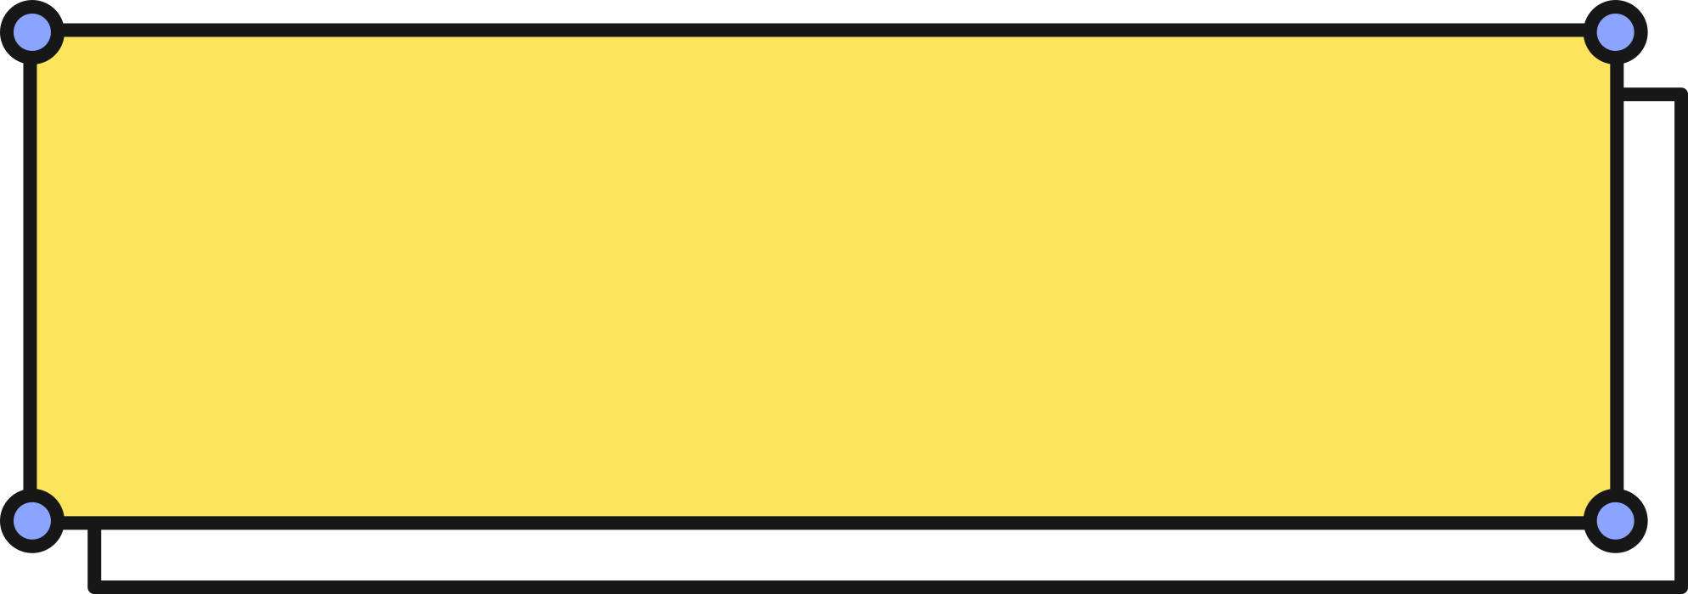
MULTIPLYING FRACTIONS BY FRACTIONS
3
1
Find
×
4
2
Three-fourths of a plate of gelatin was left after a party.
Kian had 1/2 of what was left.
Step 1
Multiply the numerators.
How much gelatin
did Kian eat?
3
1
3
=
×
=
4
2

Slide 14
MULTIPLYING FRACTIONS BY FRACTIONS
3
1
Find
×
4
2
Three-fourths of a plate of gelatin was left after a party.
Kian had 1/2 of what was left.
Step 2
Multiply the denominators.
How much gelatin
did Kian eat?
3
1
3
=
×
=
4
2
8

Slide 15

MULTIPLYING FRACTIONS USING AREA MODELS
Step 1
Divide the rectangle by four, then shade 3/4.
3
4
3
×
1
Find
4
2

Slide 16

MULTIPLYING FRACTIONS USING AREA MODELS
Step 2
Divide the rectangle by two, then shade 1/2.
3
4
3
×
1
Find
4
2
1
2

Slide 17
MULTIPLYING FRACTIONS USING AREA MODELS
Final Answer
3
×
1
Find
number of overlapping sections
4
2
3
total number of sections
8

Slide 18

TRY THIS!
Jam has 4/5 kg of buckwheat flour, and needs 1/4 of it in a recipe.
How much does
the recipe use?
Show how you solve the problem using an area model.

Slide 19
TRY THIS!
ANSWER KEY
4
5
Jam has 4/5 kg of buckwheat flour, and needs 1/4 of it in a recipe.
How much does
the recipe use?
1
4
4
1
4
1
4
1
=
Find
×
=
20
5
5
4
20
5
The recipe uses
1
of the flour.
5

Slide 20
MULTIPLYING FRACTIONS AND MIXED NUMBERS
1
1
Find
2
×
4
2
Step 1
Rewrite the mixed fraction into an improper fraction.
What if 2 1/4 of gelatin was left?
What is 1/2 of it?
8 + 1
1
9
2
4
4
2 × 4

Slide 21
MULTIPLYING FRACTIONS AND MIXED NUMBERS
1
1
Find
2
×
4
2
Step 2
Multiply the numerators, followed by the denominators.
What if 2 1/4 of gelatin was left?
What is 1/2 of it?
9
1
9
×
=
4
2
8

Slide 22
MULTIPLYING FRACTIONS AND MIXED NUMBERS
1
1
Find
2
×
4
2
Step 3
Simplify the final answer, if needed.
What if 2 1/4 of gelatin was left?
What is 1/2 of it?
9
1
9
1
×
=
1
4
2
8
8

Slide 23
TRY THIS!
Lin has 3 1/2 bottles of pickled apples at home. She uses 1/4 of it in a salad.
Pickled
Apples
Find how much of the pickled apple did Lin use in the salad?

Slide 24
ANSWER KEY
TRY THIS!
1
7
3
2
2
Lin has 3 1/2 bottles of pickled apples at home. She uses 1/4 of it in a salad.
7
1
7
Find how much of the pickled apple did Lin use in the salad?
×
=
2
4
8
7
Lin used
of the pickled apple she
8
has at home.

Slide 25

REVIEW
Fractions by
Fractions
Fractions and Mixed Numbers
Multiply the numerators, followed by the denominators.
Simplify fractions as needed.
Rewrite mixed numbers to improper fractions.
Then, follow the same steps when multiplying fractions by fractions.

Slide 26

ASSIGNMENT
How is multiplying fractions similar to dividing fractions?
Try this!
6 kg of mangoes are being shipped in boxes.
Number of boxes?
If each box holds 1/4 kg of mangoes, how many boxes are needed?

Slide 27
RESOURCE
PAGE
Use these design resources in your Canva Presentation.
This presentation template uses the following free fonts:
Titles: Body Grotesque Large Bold
Headers: Body Grotesque Large Bold
Body Copy: Nunito
You can find these fonts online too. Happy designing!
Don't forget to delete this page
before presenting.

Slide 28


THIS PRESENTATION TEMPLATE IS FREE FOR EVERYONE TO USE THANKS TO THE FOLLOWING:
SlidesCarnival for the presentation template
Pexels for the photos
HAPPY DESIGNING!

